Slide 1
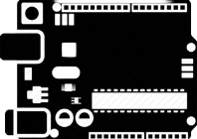
IoT BASED SMART SINK
PH SENSOR
ARDUINO KIT
WITH THEIR SPECIFIC CODE
CONNECTED
+
+
REQUIREMENT TOOLS
REQUIREMENT TOOLS
SOIL MOISTURE SENSOR
ALLOW
CONNECTED
SOLENOID VALVE
5.5 TO 7.5 PH
SONAR SENSOR
CONNECTED
TO DETECT LEVEL OF WATER
OTHER THAN
5.5 TO 7.5 PH
PUMP
12V DC

